Slide 1
Module: Design
Coupling and Cohesion
Effective modular Design

Slide 2
Desired Component Interaction
Maximize internal interaction (cohesion)
  easier to understand
  easier to test
Minimize external interaction (coupling)
  can be used independently
  easier to test
  easier to replace
  easier to understand

Slide 3
Coupling: Degree of dependence among components
No dependencies
Loosely coupled-some dependencies
High coupling makes modifying parts of the system difficult, e.g., modifying a component affects all the components to which the component is connected.
Highly coupled-many dependencies

Slide 4
Range of Coupling
High Coupling
Content
Common
Control
Stamp
Data
Uncoupled
Loose
Low

Slide 5
Data Coupling
Definition: Two components communicate by passing data items.
Every argument is simple argument.
Good, if it can be achieved.
Easy to write and modify component independently.

Slide 6
Data Coupling
Square (int x)
{
return(x*x);
}

Slide 7
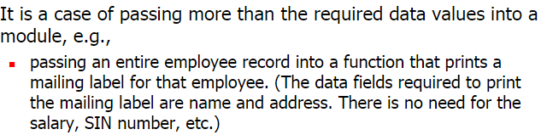
Stamp Coupling
Definition: Component passes a data structure to another component.
Data structure can be structure, class, copy constructor.
Notes:
Be sure you know the difference between the insightful designer and the lazy programmer.
Know what tradeoffs you are making in your design.

Slide 8
Example
Customer billing system
The print routine of the customer billing accepts a customer data structure as an argument, parses it, and prints the name, address, and billing information.
  double printEmployee(Employee& e);
  Better
  double printEmployee(
  String Name,
  String Address,
  float billAmount);

Slide 9

Control Coupling
Definition: Component passes control parameters to coupled components.
The manner or degree by which one software component influences the execution of another software component.
One module passes data that is used to control the flow of execution of other module.
Notes:
Example of good: Sort that takes a comparison function as an argument.
The sort function is clearly defined: return a list in sorted order, where sorted is determined by a parameter.

Slide 10
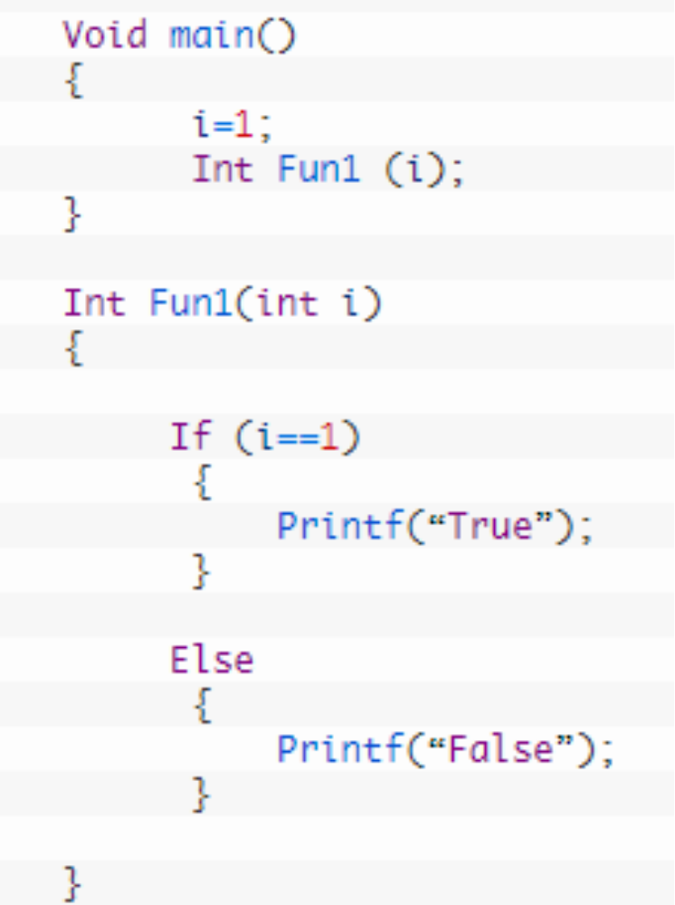
Control Coupling
Notes:
Example of good: Sort that takes a comparison function as an argument.
The sort function is clearly defined: return a list in sorted order, where sorted is determined by a parameter.

Slide 11
Common Coupling
Definition: All modules have read/write access to a global data block.
Using global variables (i.e., global coupling)
Modules exchange data using the global data block (instead of arguments)
Single module with write access where all other modules have read access is not common coupling

Slide 12

Content Coupling
Definition: A module directly references the content of another module
  module p modifies a statement of module q
  Module p refers to local data of module q
  Reusing module p requires using module q
Typically only possible in assembly languages

Slide 13
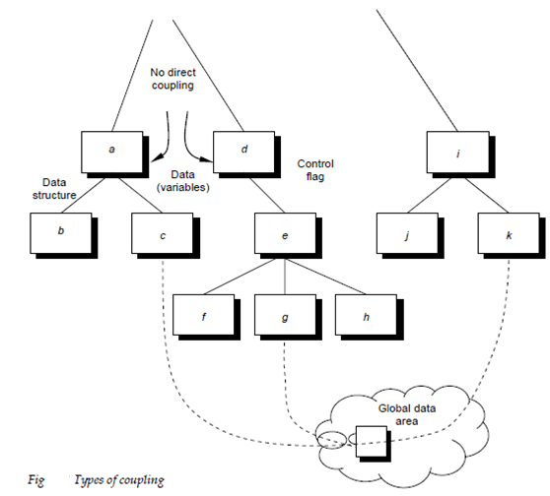
Coupling

Slide 14
Cohesion
Definition: The degree to which all elements of a component are directed towards a single task are contained in a single component.
All elements of a component are directed toward and essential for performing the same task
High is good

Slide 15
Range of Cohesion
High Cohesion
Functional
Sequential
Communicational
Procedural
Temporal
Logical
Coincidental
Low

Slide 16
Coincidental Cohesion
Definition: Parts of the component performs multiple, completely unrelated actions
No reusability
Difficult corrective maintenance or enhancement
Elements needed to achieve some functionality are scattered throughout the system.
Accidental Worst form

Slide 17
Coincidental Cohesion - example
class Info {
public:
// converts a path in windows to one in linux
string win2lin(string);
// number of days since the beginning of time
int days(string);
// outputs a financial report
void outputreport(financedata, std::ostream&);
};

Slide 18
Logical Cohesion
Definition: Elements of component are related logically and not functionally.
Several logically related elements are in the same component and one of the elements is selected by the caller.
May include both high and low-level actions in the same class.
May include unused parameters for certain uses.
Example: grouping all mouse and keyboard input handling routines

Slide 19
Logical Cohesion
class Output {
public:
// outputs a financial report
void outputreport(financedata);
// outputs the current weather
void outputweather(weatherdata);
// output a number in a nice formatted way
void outputint(int);
};

Slide 20
Temporal Cohesion
Definition: Elements of a component are related by timing.
Component unlikely to be reusable.
Often happens in initialization or shutdown
Example: a function which is called after catching an exception which closes open files, creates an error log, and notifies the user

Slide 21
Temporal Cohesion – Example
class Init {
public:
// initializes financial report
void initreport(financedata);
// initializes current weather
void initweather(weatherdata);
// initializes master count
void initcount();
}

Slide 22

Procedural Cohesion
Definition: Elements of a component are related only to ensure a particular order of execution.
Changes to the ordering of steps or purpose of steps requires changing the module abstraction
Example: a function which checks file permissions and then opens the file

Slide 23
Procedural Cohesion – Example
class Data {
public:
// read part number from an input file and
// update the directory count
void readandupdate (data&);
};

Slide 24
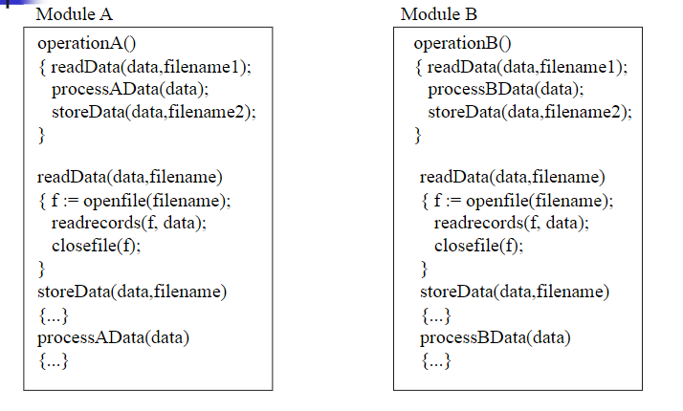


Slide 25
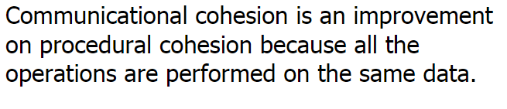
Communicational Cohesion
Definition: Module performs a series of actions related by a sequence of steps to be followed by the product and all actions are performed on the same data.
Action based on the ordering of steps on all the same data.

Slide 26
Communicational Cohesion
class Data {
public:
find title of the book;
find author of the book;
find publisher of the book;
};

Slide 27
Sequential Cohesion
Definition: Methods are together in a class because the output from one part is the input to another part like an assembly line.
The output of one element of a component is the input to another element.
Good situation
Example: a function which reads data from a file and processes the data.

Slide 28
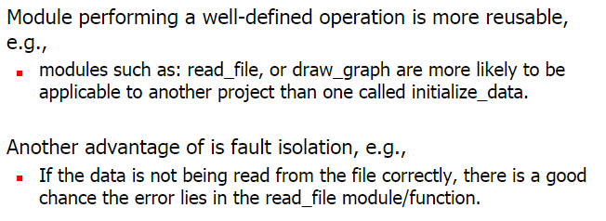
Functional Cohesion
Definition: Every essential element to a single computation is contained in the component.
Every element in the component is essential to the computation.
Ideal situation.

Slide 29
Examples of Cohesion-1
Function A
Function A
Function A’
Function A’’
Time t₀
Time t₀ + X
Time t₀ + 2X
Function
B
Function
C
logic
Function
D
Function
E
Coincidental
Parts unrelated
Logical
Similar functions
Temporal
Related by time
Function A
Function B
Function C
Procedural
Related by order of functions

Slide 30
Examples of Cohesion-2
Function A
Function B
Function C
Function A
Function B
Function C
Communicational
Access same data
Sequential
Output of one is input to another
Function A part 1
Function A part 2
Function A part 3
Functional
Sequential with complete, related functions

